Slide 1
Scavengers
Abhra Sinha
Pratik Walawalkar
Eshan gupta

Slide 2
Overall approach
Precise control at slow speeds by accurate steer action when line camera detects a turn
Gradually increasing the speed of the car to compete for time
System stability and robustness
Simple control algorithm but accurate
Testing out components one at a time and tuning them for the competition
Modifying certain parameters to achieve accuracy and reduce delay
Testing out p control for smoother turns

Slide 3

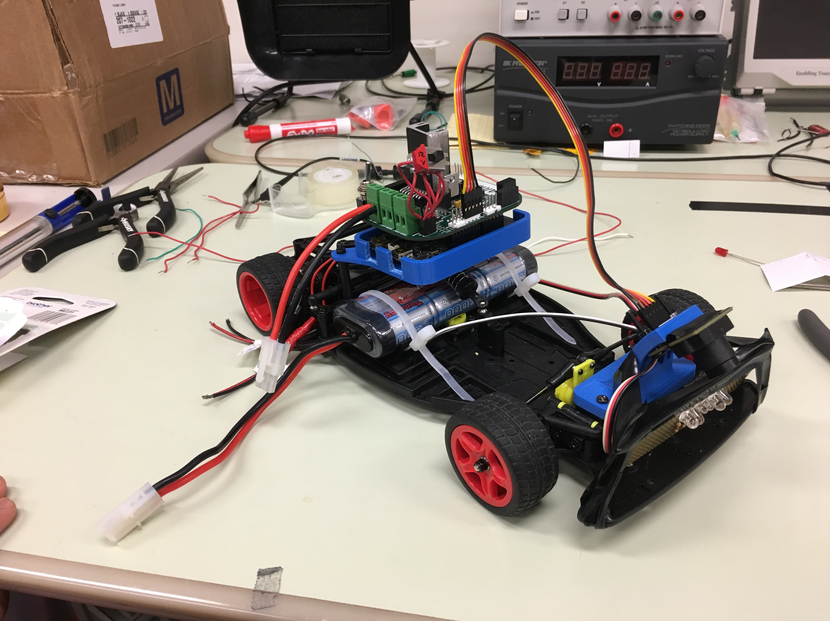
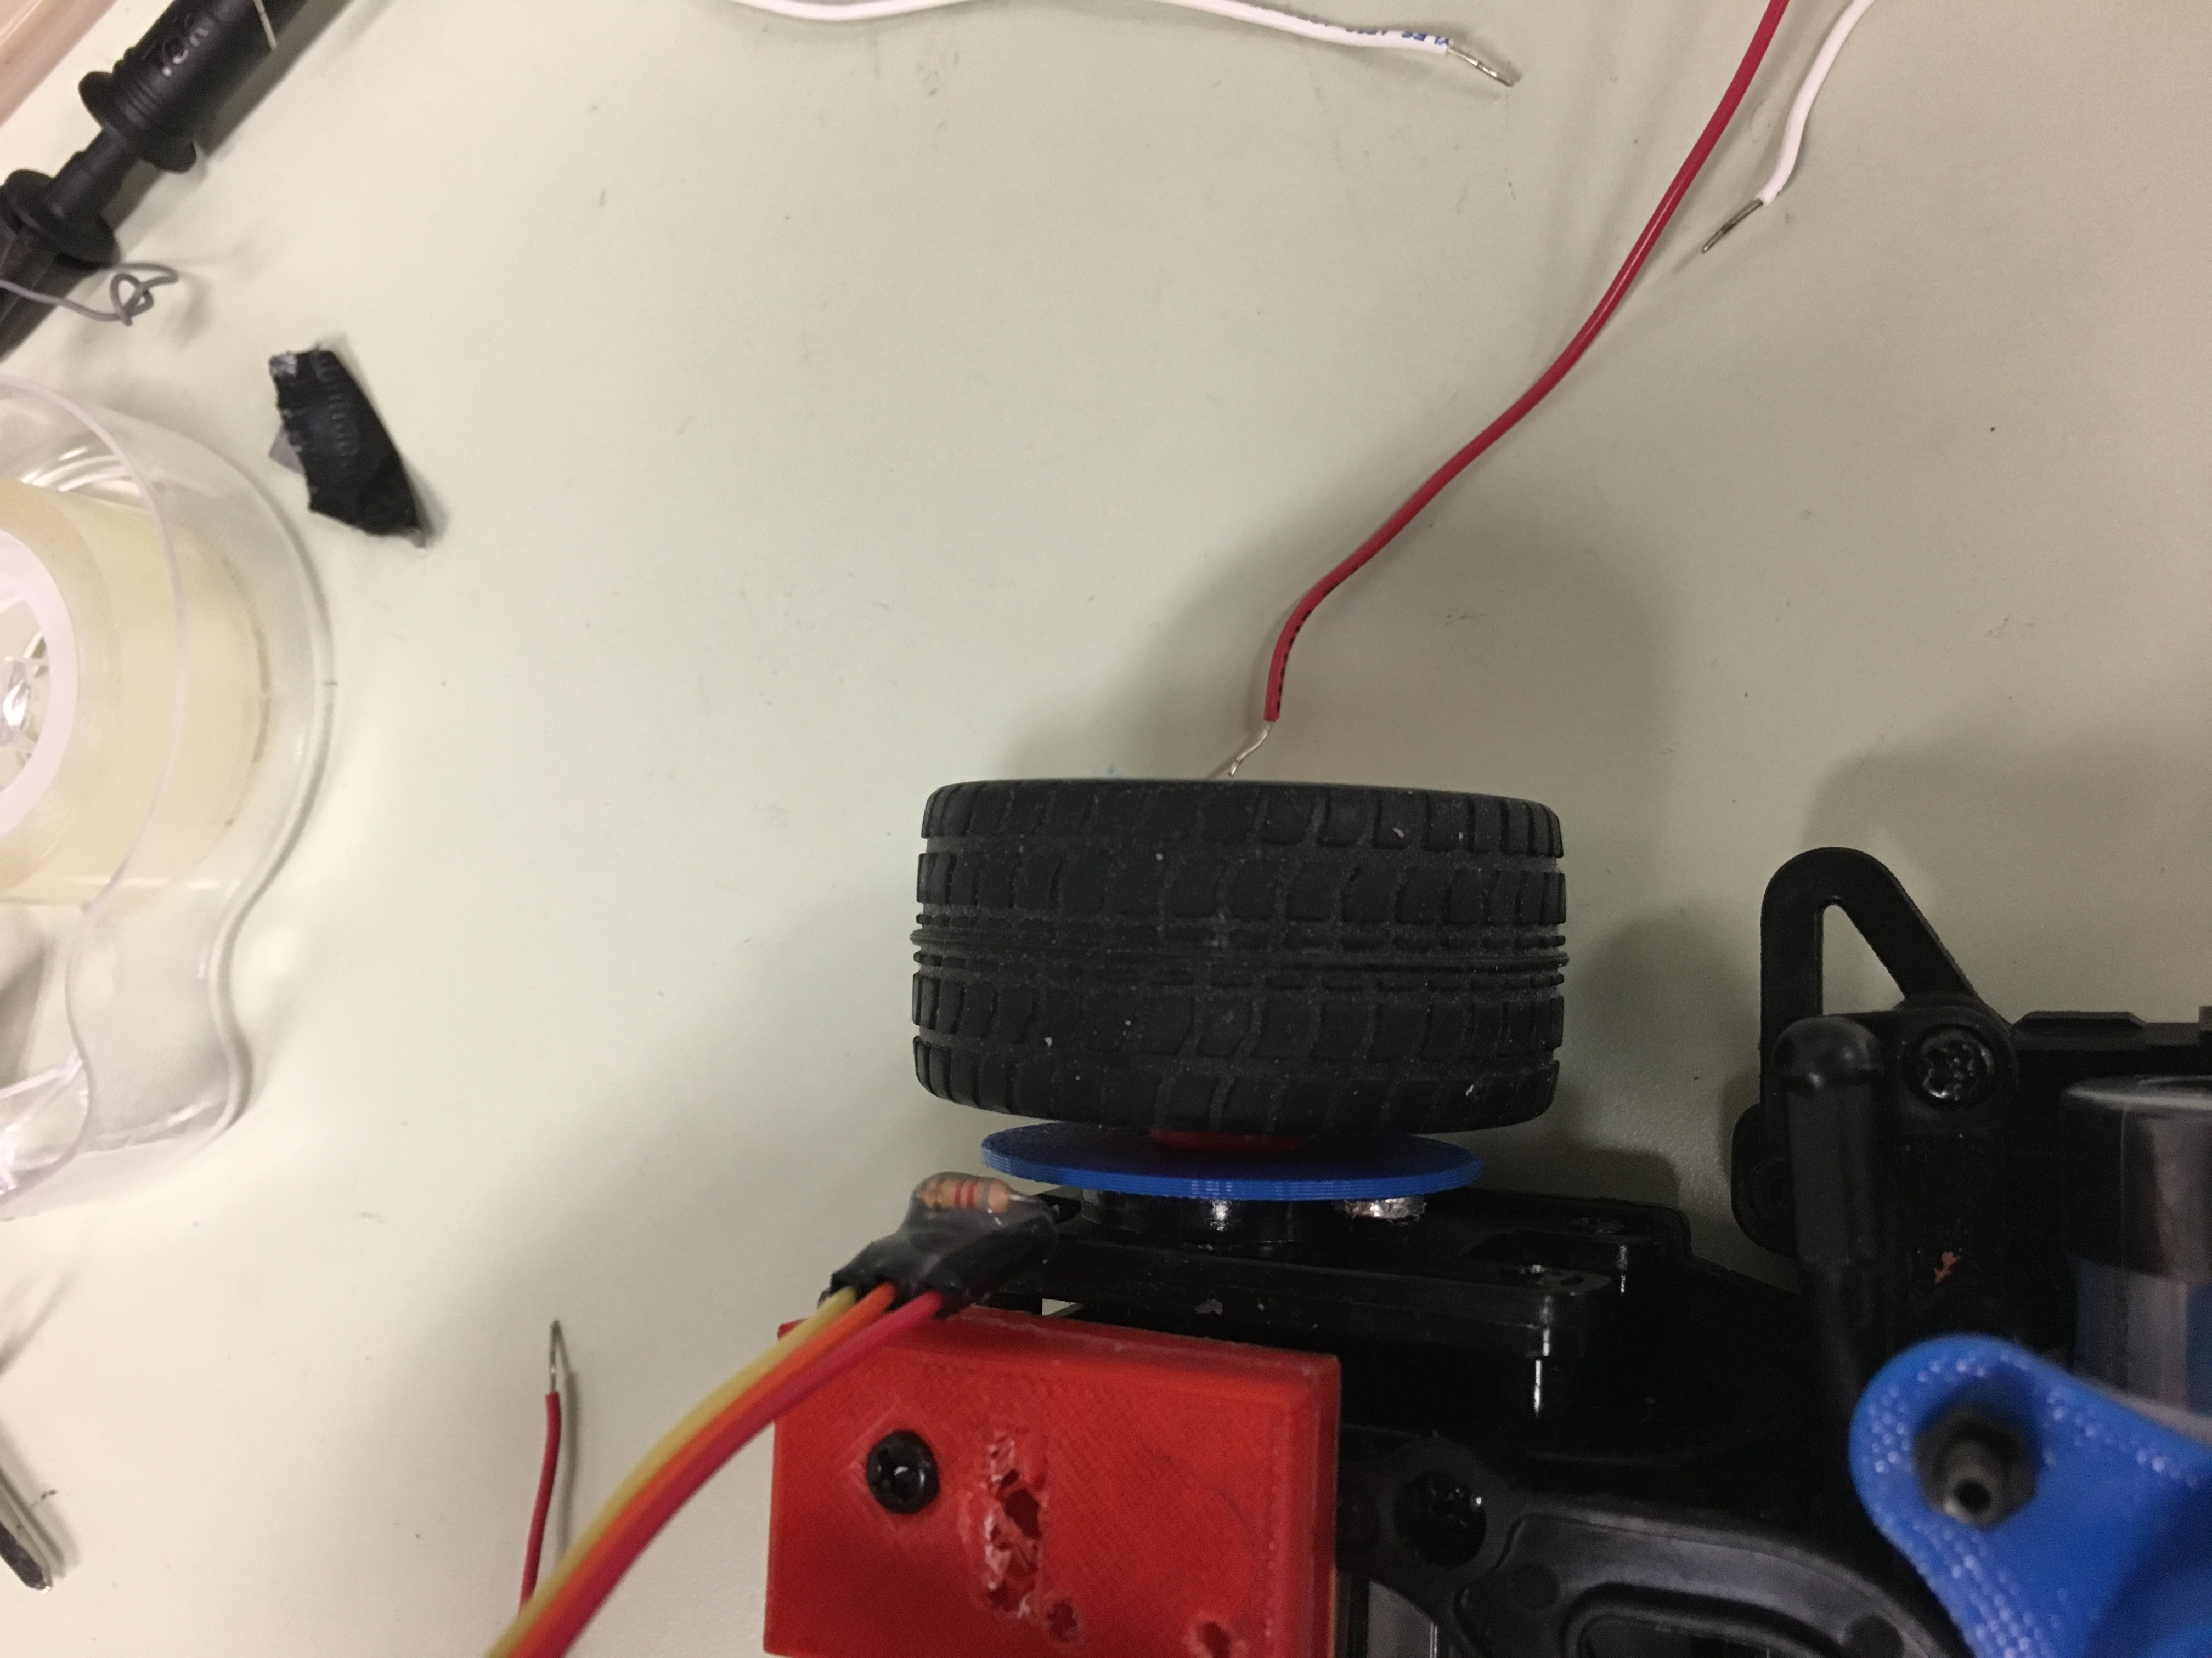
SHIELD + Microcontroller
Magnets
Battery
Hall Effect Sensor
Camera
Servo Motor
LED Array

Slide 4
BLOCK DIAGRAM
Power Supply
7.2V
Boost Converter and Regulator Circuit
5V
SERVO MOTOR
LEDs
5V
5V
5V
PWM
Line Position
LINE CAMERA
FRDM KL25Z Microcontroller
12 V
Speed
PWM
HALL EFFECT SENSOR
DC Motor Driver Circuit
Control Signal
Brushless DC Motors

Slide 5
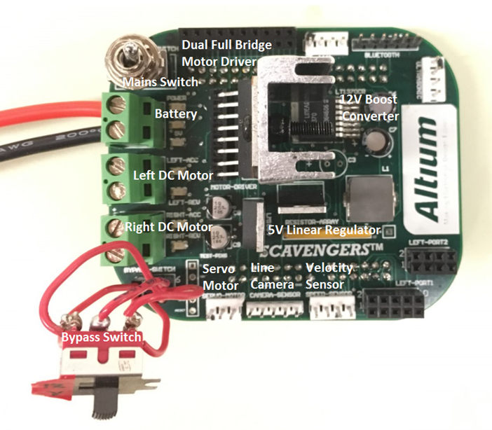
PCB with components

Slide 6
Additional Components
LED ARRAY – For Better peak detection in output of line camera
3D PRINTED SHIELD BOARD HOLDER – to anchor the shield and microcontroller
3D PRINTED CIRCULAR DISC – to place the magnets
Heatsink – allow for heat dissipation from the motor driver

Slide 7
VELOCITY CONTROL
We are using Hall effect sensor to serve velocity sensing purpose
OUR ALGORITHM:
Timers are used to run the program for example 5 seconds (t= 5 sec)
interrupt function is used to count the number of pulse encountered during the a period of 5 seconds.
These interrupts counts the number of rising pulse
To measure Speed simple formula is used -
(Feet/sec = 2 * Pi * wheelradius * (Pulsecount -1) / t )
We aim to slowly increment the speed without compromising the navigation of the car.

Slide 8
LINE FOLLOWING algorithm
Detecting the output from the line camera and storing it in an array of size 128
Detecting the minimum value in the array and assigning the value to a variable
Finding the readings around the minimum value and checking to see if it forms a slope
Keeping a count of that value and calculating the position of the line based on the slope count and min value
We detect the position of the line in this way

Slide 9
Control strategy
Based on the line value that we have detected we get the current position of the line
We set the target position value to 64 and calculate error
Implement a Proportional controller to give the appropriate value of the PWM according the current position
Tuning the values of Kp for better response
Based on the current position we set the speed of the motors and also with respect to the hall sensor
At turns we slow down the speed to allow sharper turns and prevent offshoot
In case the speed slows down as detected from the hall effect sensor, we increase the PWM pulse to compensate for the slowing motion of the motor

Slide 10
PROBLEMS faced
PCB – assigning internal layers and calculating thickness of the tracks
PWM Pulse – tuning right values for both dc and servo motors
IDE – Kinetis Design Studio code generation, looked for alternatives, chose mbed development platform
Board Firmware – had issues with windows 10 and mBed, firmware update and flashing
Test circuit of motor driver – FETs burning out due to high junction voltage
Voltage adjust – changing the values of the resistor bridge to get stable output
Soldering –two pins of boost converter were shorted while smd soldering
Excessive heating – motor drivers faced excessive heating
Voltage dropout – excessive current draw from servo motors leading to significant drop in system voltage
Servo motors current draw – hard left turn drawing excessive current and stalling the entire system
Left turn not happening - initial value of the for loop to bet adjusted for window of camera readout

Slide 11
Lessons learned
Electronics aren’t 100% reliable and can give up at the last moment
Practical scenario is much different from ideal
Higher range of error to be considered when selecting certain components
Thinking simple and straight to get solutions to complex problems
Identifying mistakes and taking corrective actions

